Slide 1
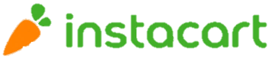
Instacart Data Analysis

Slide 2
01
Introduction
03
Analyzing
Instacart introduction
Data introduction
EDA
Data processing for prediction
Feature engineering
Prediction
Association rules
E-COMMERCE
INTERNET SHOPPING
02
Define problems
04
Conclusion
Competitor comparison
SWOT analysis
Precise marketing
Target
What can we do with the analyzing result?
AGENDA

Slide 3
Introduction
What’s Instacart?
How to transact on instacart?
Where is our data from?
What’s inside the data?

Slide 4

Instacart Introduction
What’s Instacart?
INTERNET SHOPPING
million
revenue
Website & mobile app
year
Grocery delivery
Instacart’s revenue is increasing year by year.
Pick-up service
Notes:
Instacart is an American company that operates a grocery delivery and pick-up service in the United States and Canada. The company offers its services via a website and mobile app, on which customers can order groceries from participating retailers with the shopping being done by a personal shopper.

Slide 5
Instacart Introduction
Transaction flow in Instacart
Step1.
Select your groceries from 30,000+ items at stores like Whole Foods, Costco, Malmart…etc.
Step2.
Instacart routes your order to a vetted Personal Shopper who collects your item.
Step3.
Your order will be delivered on scheduled time.

Slide 6


Data Introduction
Where the data from?
Data is offered by Instacart on a kaggle competition
‘Instacart Market Basket Analysis’

Slide 7
Data Introduction
Data columns
Order
Order_id
Total 3,421,083 orders
Order_number
Each user’s order number
order_dow
In what day the order was made
order_hour_of_day
On what time the order was made
Product
Product_id
total 49,688 products
Aisle_id
Total 134 aisles
Department_id
Total 21 departments
Add_to_cart_number
In what position a product put in a cart
User
User_id
Total 206,209 users
Days_since_prior_order
In how many days user order since last order
Reordered
Reordered
0 refers to non-reordered
1 refers to reordered

Slide 8
Define problems
Who are Instacart’s competitors?
What are instacart’s advantages and disadvantages?
How to defeat competitors?
Whart’s our analyzing goal?

Slide 9
Competitors
 | instacart | Amazon Fresh | Walmart Grocery | FreshDirect | Peapod
Founding Date | 2012 | 2007 | 2007 | 2002 | 1996
Shipping fee | $3.99/min$10; Free/min$35 | Free | $7.95 to $9.95; Free/Delivery Unlimited | $5.99-$15.99 /min$30; Free/Delivery Pass | Varies by order total; free with PodPass or with min$100
Plus & minus | Plus: Shop at your favorite stores 2-hour delivery Minus: Delivery fees can add up | Plus: Free 2-hour delivery Whole Foods products Minus: Requires membership | Plus: Low Walmart prices Access to many types of products Minus: High delivery fees | Plus: High-quality groceries Prepared meals and meal kits Minus: Limited coverage area | Plus: Great sign-up deal Double coupons Minus: Limited coverage area
Type | Private | Subsidiary | Public | Private | Subsidiary
Products | Groceries non-perishables | Groceries non-perishables (including Whole Foods) | Groceries, non-perishables, other Walmart products | Food Beverage Technology | Groceries non-perishables
Locations | Total 51 states in US and CN | 2000+ cities | 1,600+ cities | 8 states in US | New England & mid-Atlantic state

Slide 10
SWOT analysis
Distribution and growth.
Instore promotion.
Higher delivery fee compared to other delivery company.
Deliver/Success is dependent on external factor(weather, temperature…)
S
W
Wide partnership and expansion.
Fast delivery and good scheduling.
Strengths
Weakness
O
T
Better recommendation system.
Well established competitors
Expansion into international market.
Opportunities
Threats
Replicable business model and price.
Potential contract with more retailers
Instore promotion and service quality.

Slide 11
Precise Marketing
UP
Marketing Cost
Once we can precisely know who will buy and what will be ordered, we can release coupon or make commercials base on user behavior..
Improve recommendation system
Through data analysis find user order behavior, so that we can improve recommendation system in order to fulfill precise marketing.
Cut marketing cost
Through data analysis find user order behavior, so that we can cut down marketing cost but reach the selling goal as in the past or better than the past.
Revenue
Once we can precisely know who will buy and what will be ordered, the platform will attract more customers and create more repurchases..
DOWN

Slide 12
Target
What can we do with the data?
. Find the association between products
Finding the association between products in orders can help us to know which products customers usually buy together, and based on it we can develop a recommendation system to recommend customers which products to buy as long as we have his/her order records.
. Find which customer will reorder and which products will be reordered
We can predict what will the customers buy in the next order and whether the customer will reorder by analyzing their order history, so that we can do marketing and release coupons based on the prediction result, in order to meet our precise marketing goals.
Analyzing goal
Association between products
Prediction on reordered products

Slide 13
Analyzing
How to analyze the data?
What insights did find in the data?

Slide 14
Analyzing Process
create features
feature clustering
User feature choosing
preprocessing data exploratory
Find the relationship between products
feature engineering
EDA
association
ANALYZING PROCESS
data processing for prediction
prediction
rebuild table
dealing with unbalanced data
model selection
model building

Slide 15
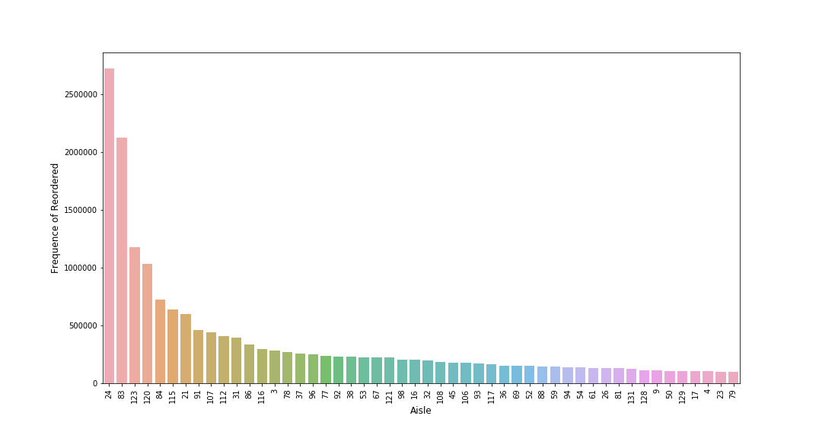
EDA
Products in different aisles have different reordered number, so we can refer that the position of products locate and the type of products will affects the reordered state of products.

Slide 16
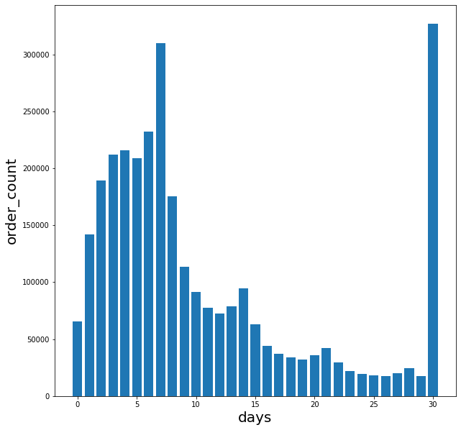
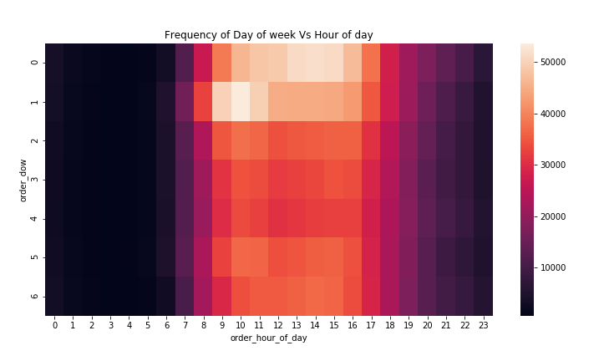
EDA
Most of the orders were made in the weekend morning every 7 days or every 30 days.
We can refer that user order behavior is deeply related with the order amount.

Slide 17
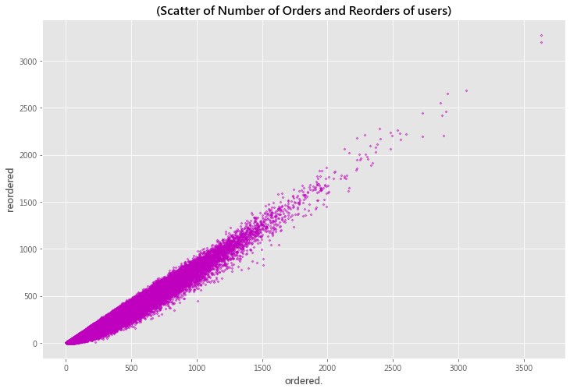
EDA
When a user orders more products, there is a higher probability for him/her to reorder products.
As a result, at the following analysis, we will treat the product-related variables and user-related variable as variables that could have powerful effects on reorder state.

Slide 18
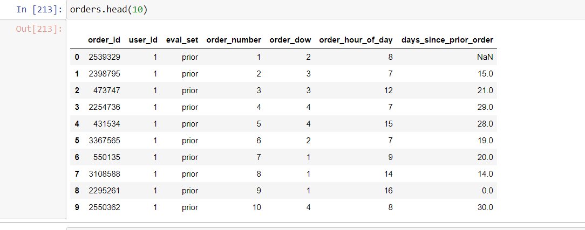
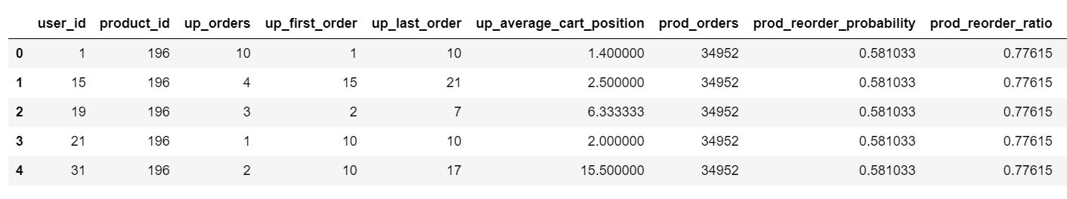
Data processing for prediction
Rebuild table
Training data
each user’s prior orders(excluding last order)
Prediction target
I use the last order of some customer as predicting target in the train data, in order to predict next order of customers who are in test set.
last
Solution
Use each user and each product as a combination, predict whether the combination will show up in the next order
Notes:
We define our predicting target as next order of each customer.

Slide 19
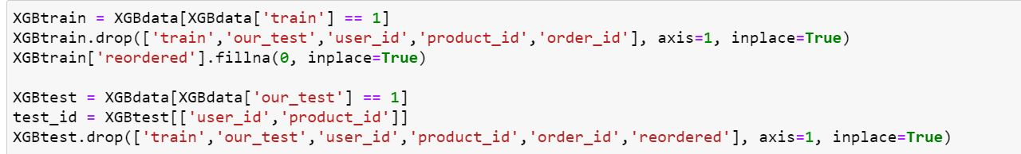
Data processing for prediction
Split data into train set and test set
Split
We take 6:4 to split data into train and test set
Notes:
After defining the predicting target and rebuilding the table, I started to split the new data into train set and test set.

Slide 20
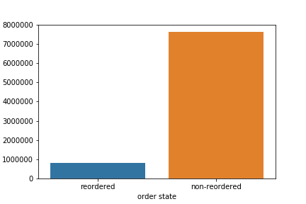
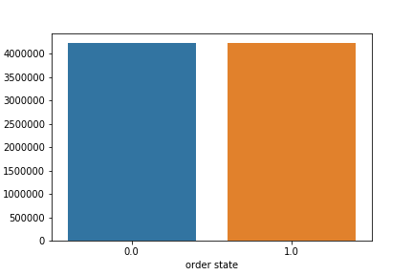
Data processing for prediction
Dealing with unbalanced issue in train set
Unbalanced
balanced
reordered number is much less than the non-reordered number
reordered number is equal to non-reordered number
Bootstrapping
Notes:
After rebuilding the data, I found that the reordered number is much less than the non-reordered number
So that I need to deal with the unbalanced problem with bootstrapping method.

Slide 21
Feature engineering
Create features
User features
 | User_order User_period User_mean_days_since_prior User_total_product User_reorder_ratio User_distinct_products Order_dow Order_hour_of_day User_average_basket Days_since_prior_order
 | Order
 | Order_id Total 3,421,083 orders Order_number Each user’s order number order_dow In what day the order was made order_hour_of_day On what time the order was made
 | User
 | User_id Total 206,209 users Days_since_prior_order In how many days user order since last order
Notes:
Create some valuable features for users

Slide 22
Feature engineering
Create features
Create features
Products features
 | Aisle_id Department_id Prod_orders Order_probability Prod_reorder_ratio
 | Products
 | Product_id total 49,688 products Aisle_id Total 134 aisles Department_id Total 21 departments Add_to_cart_number In what position a product put in a cart
 | Order
 | Order_id Total 3,421,083 orders Order_number Each user’s order number order_dow In what day the order was made order_hour_of_day On what time the order was made
Notes:
Create some valuable features for products

Slide 23
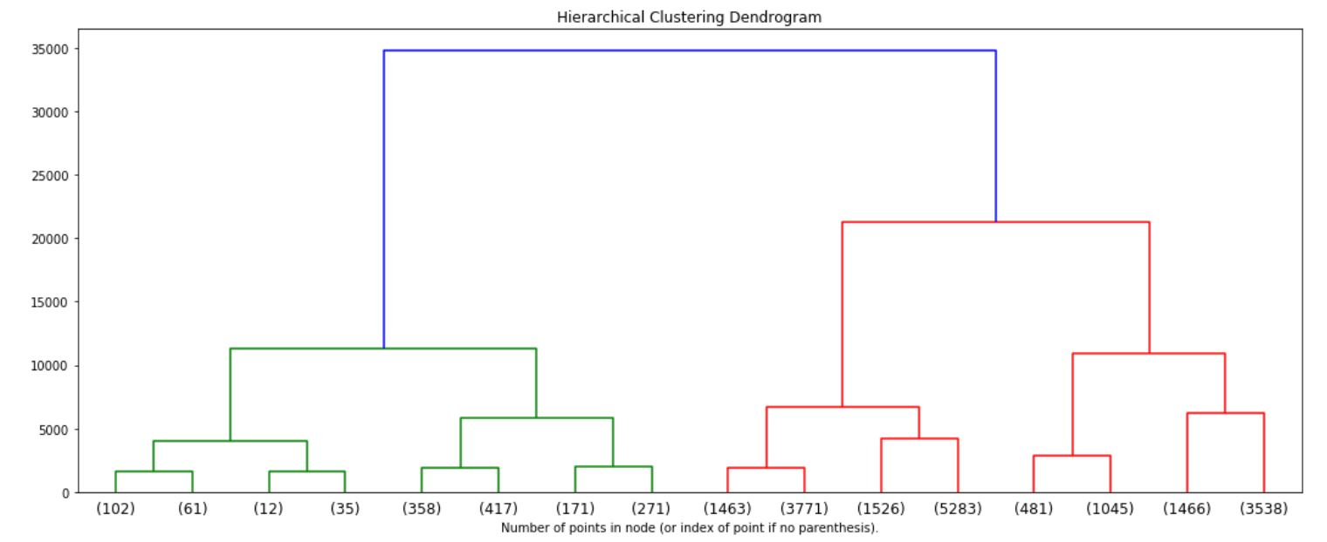
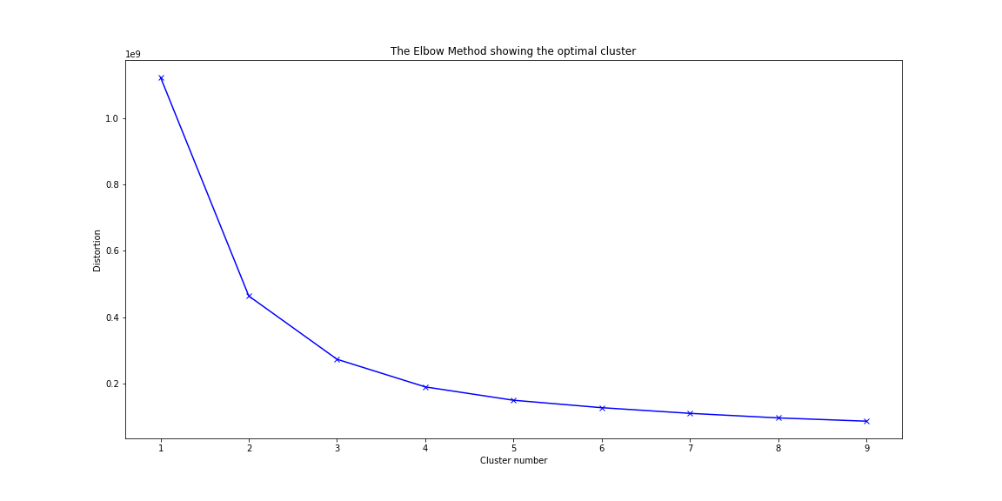
Feature engineering
Feature clustering
Notes:
I choose 3 for cluster number

Slide 24
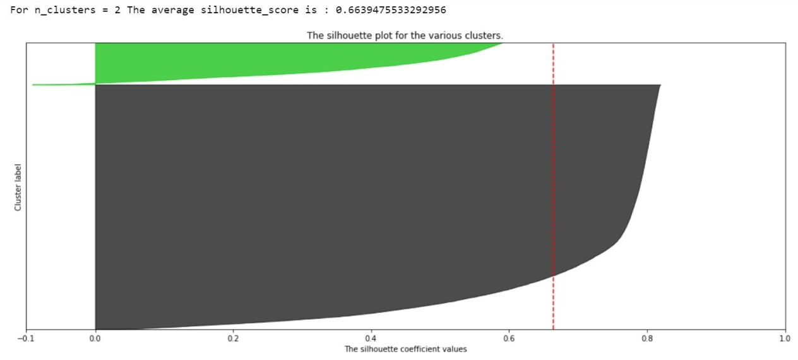
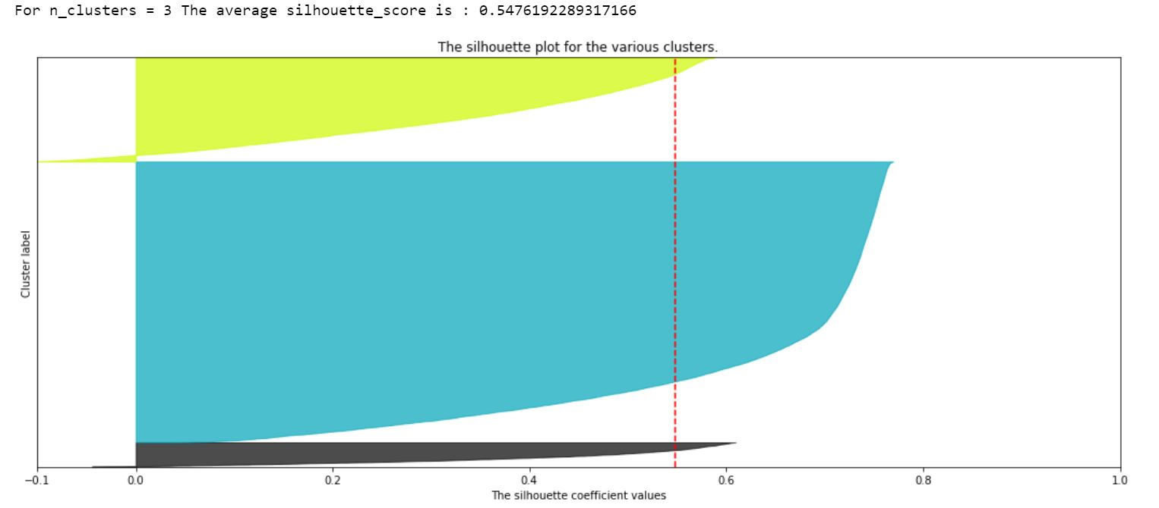
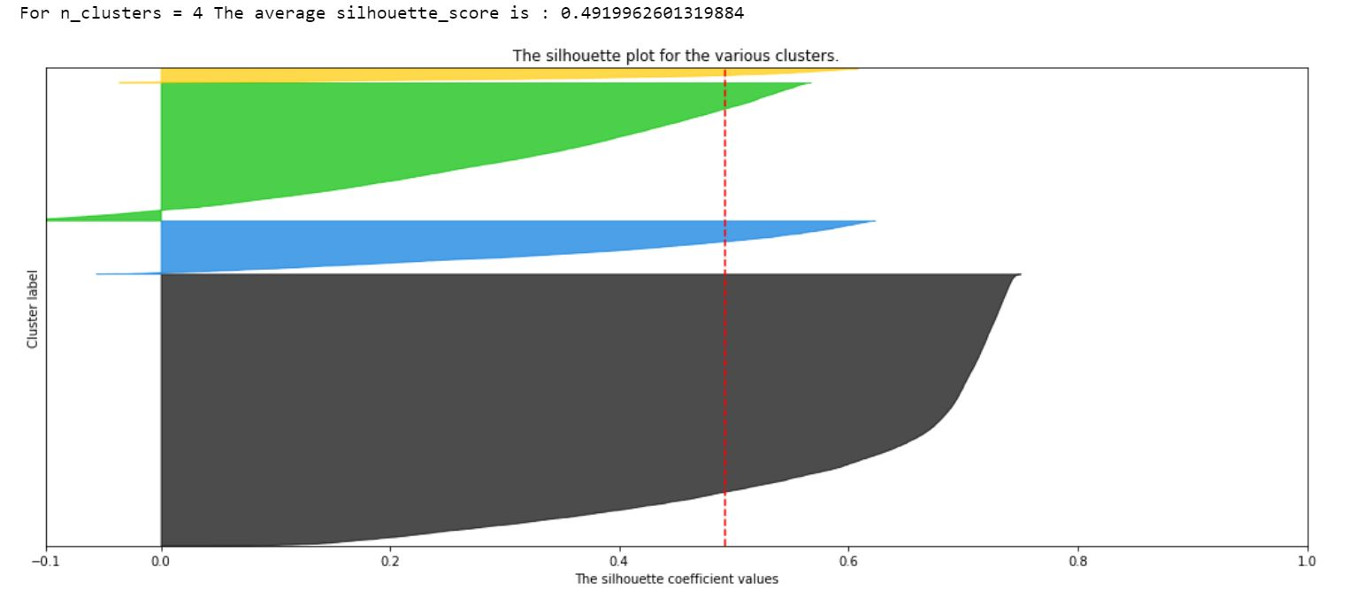
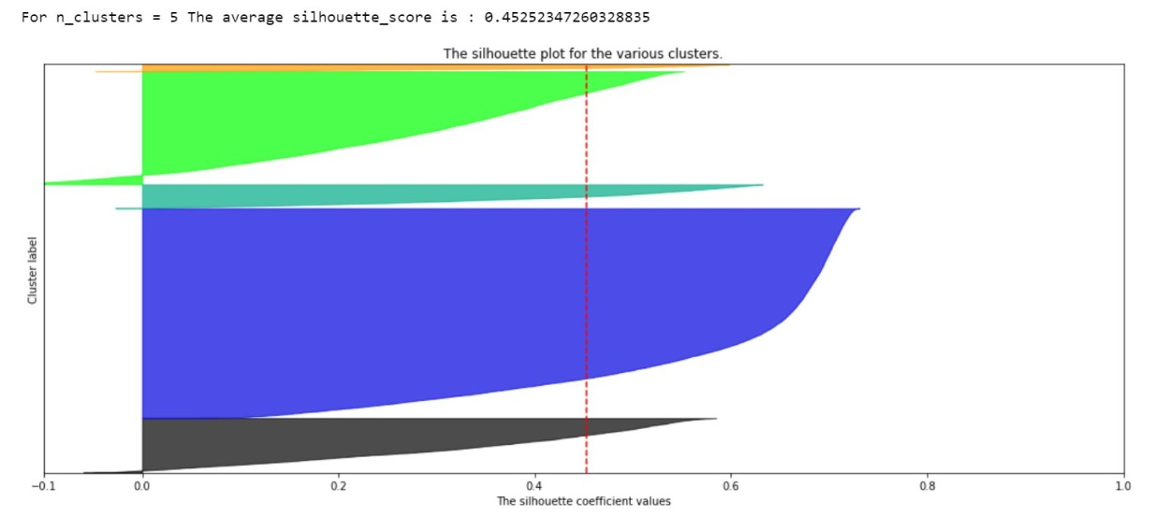
Feature engineering
Feature clustering

Slide 25
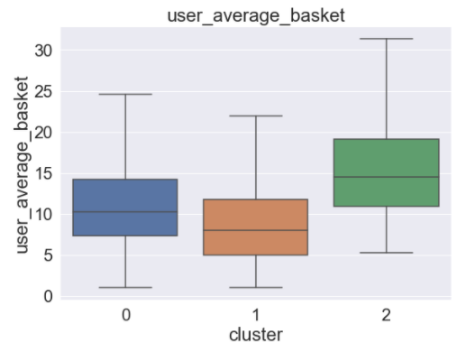
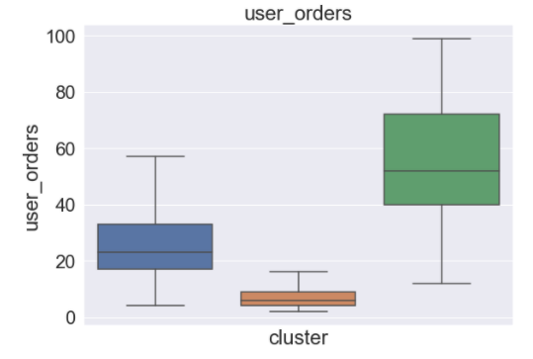
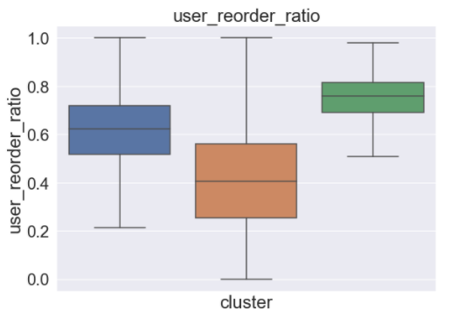

Feature engineering
Feature clustering
average product amount in one order by one customer
0 : MEDIUM 1 : LOW 2 : HIGH
Order amount by one customer
0 : MEDIUM 1 : LOW 2 : HIGH
Reorder ratio by one customer
0 : MEDIUM 1 : LOW 2 : HIGH

Slide 26
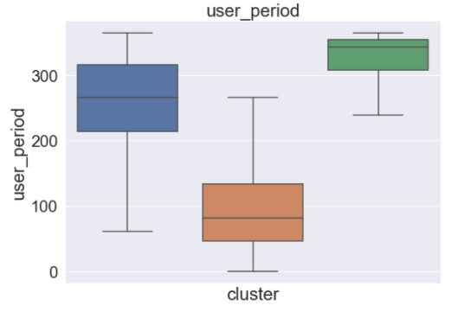
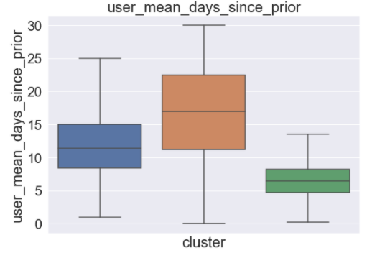
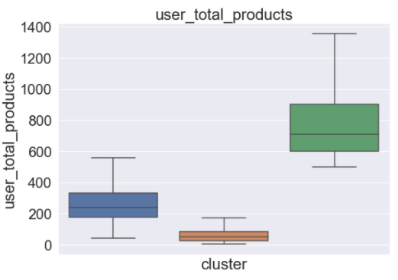
Feature engineering
Feature clustering
Days have passed since the first time visit the site
0 : MEDIUM 1 : LOW 2 : HIGH
Days have passed since the consumer’s last purchase
0 : Medium 1 : HIGH 2 : LOW
Products amount by one customer
0 : MEDIUM 1 : LOW 2 : HIGH
Notes:
We can say that group 2 is high-contributed group, group 1 is low-contributed customer group

Slide 27
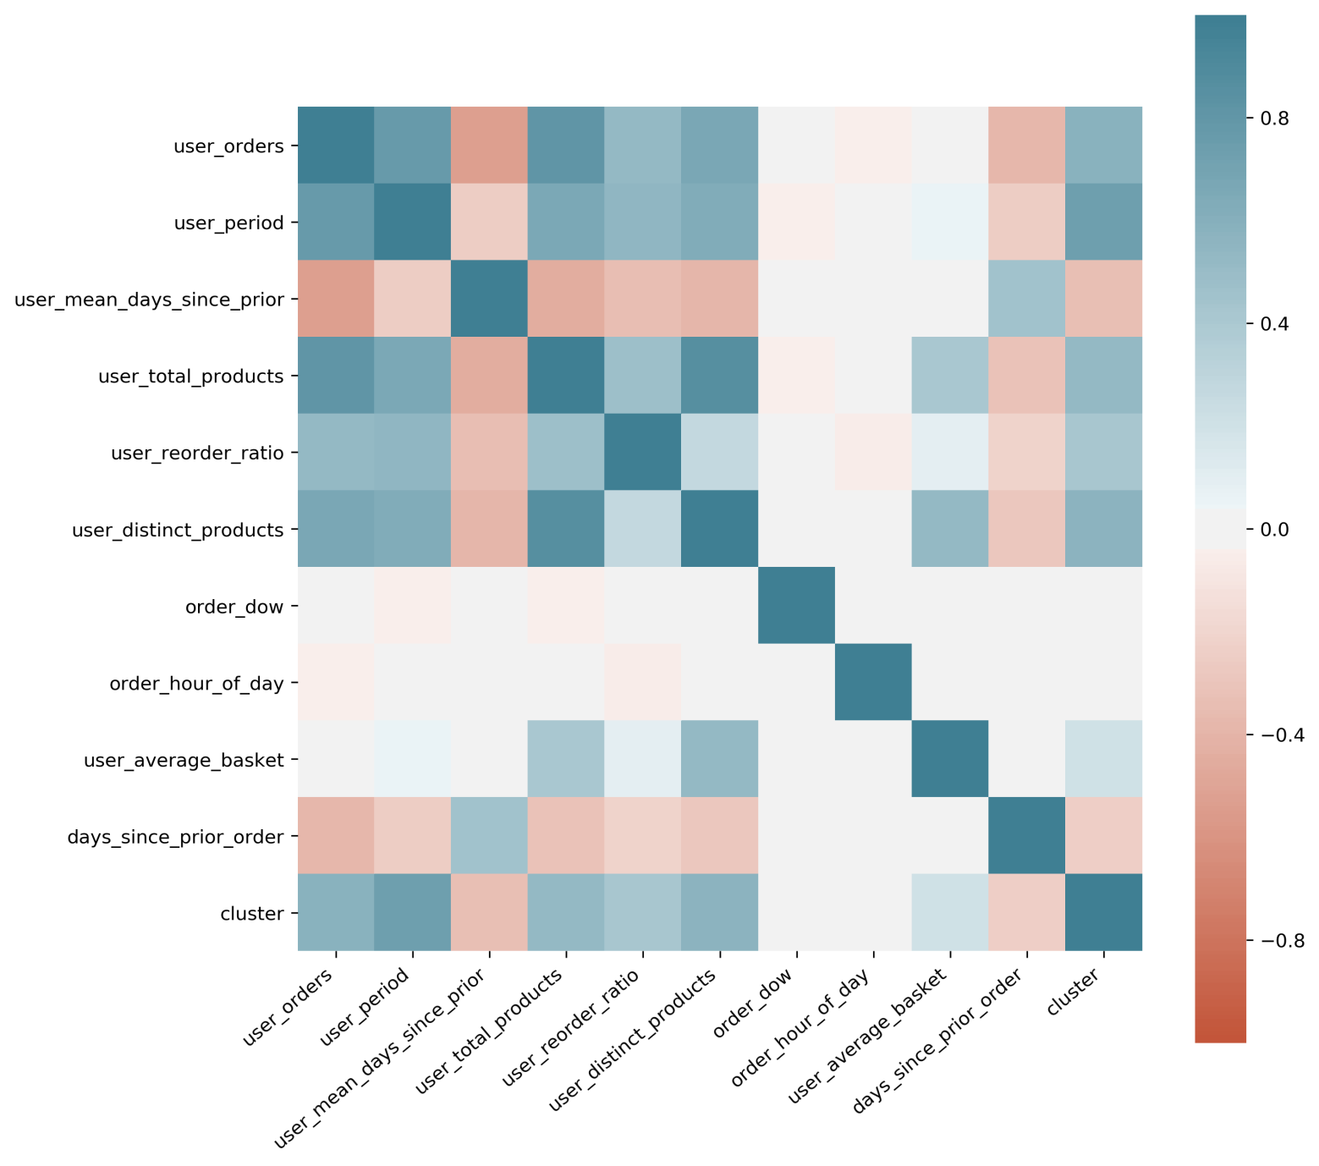
Feature engineering
User features choosing
Variable order_dow and order_hour_of_day are weak correlated with user_reorder_ratio.
So I exclude these two variables out of the user features.

Slide 28
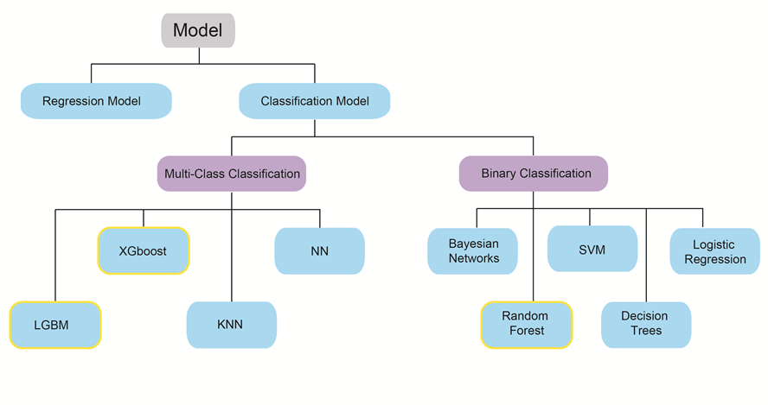
Prediction
Model selection – All classification models
Credit by Iv chen

Slide 29
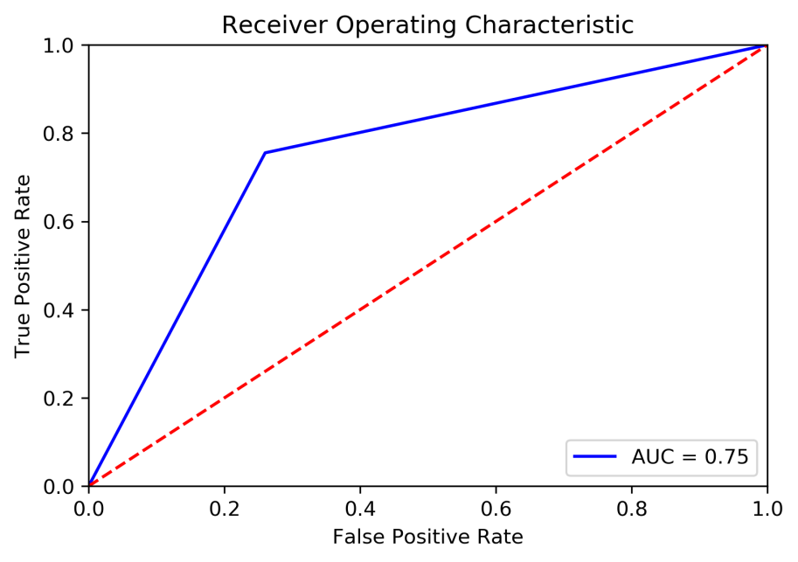
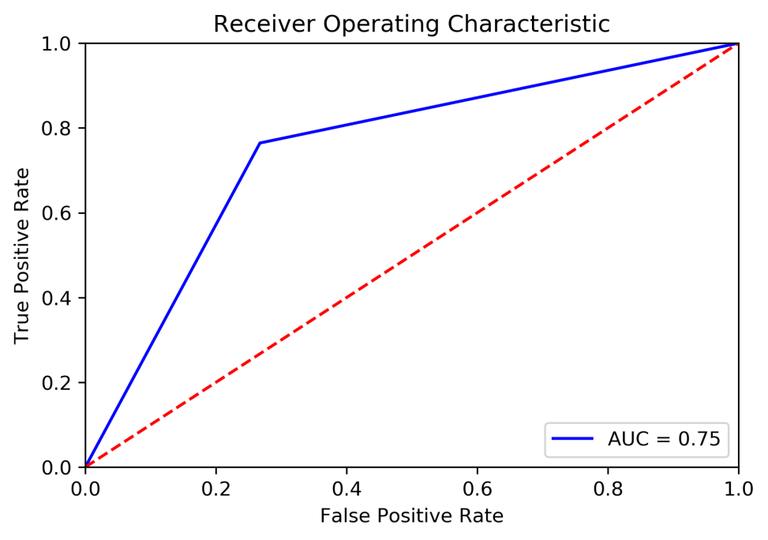
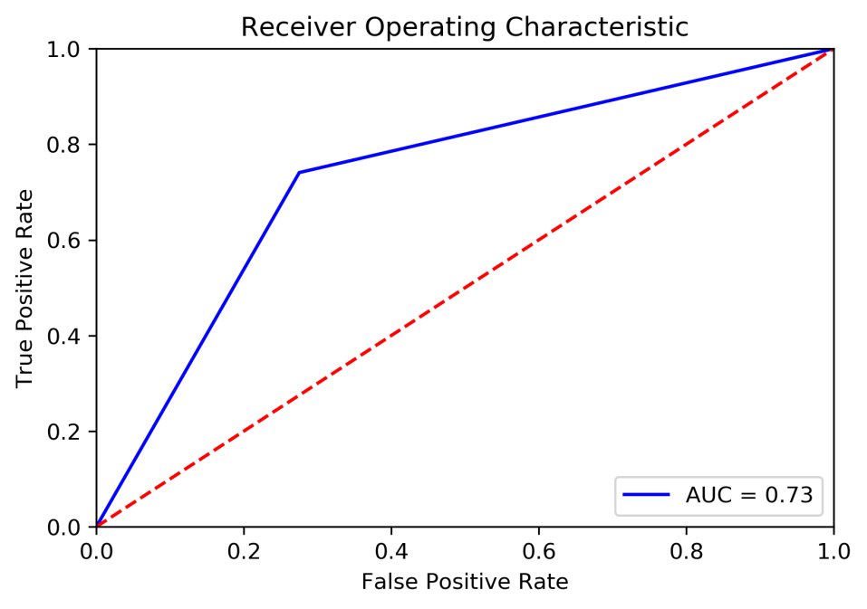
Prediction
Model selection – All classification models
XGBoost – binary
LGBM – binary
RF – binary
Auc = 0.75
F1 score = 0.60
Auc = 0.75
F1 score = 0.60
Auc = 0.73
F1 score = 0.59

Slide 30
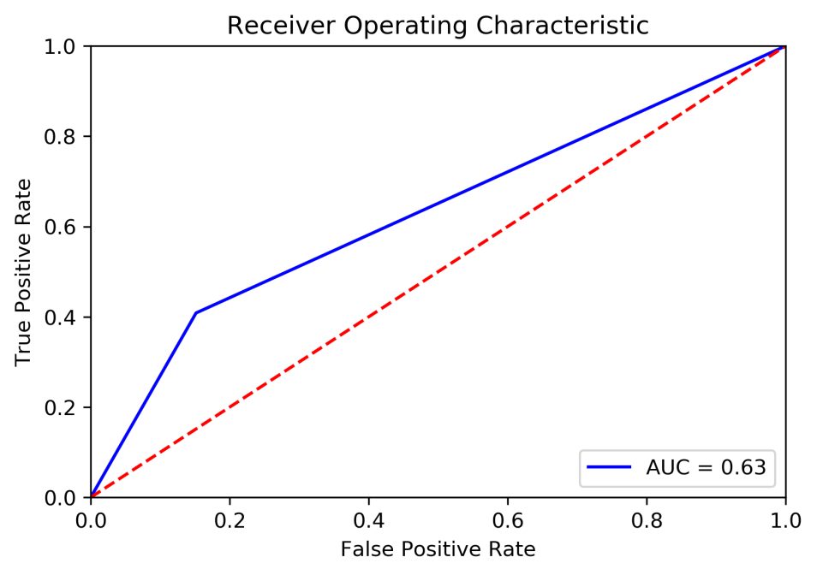
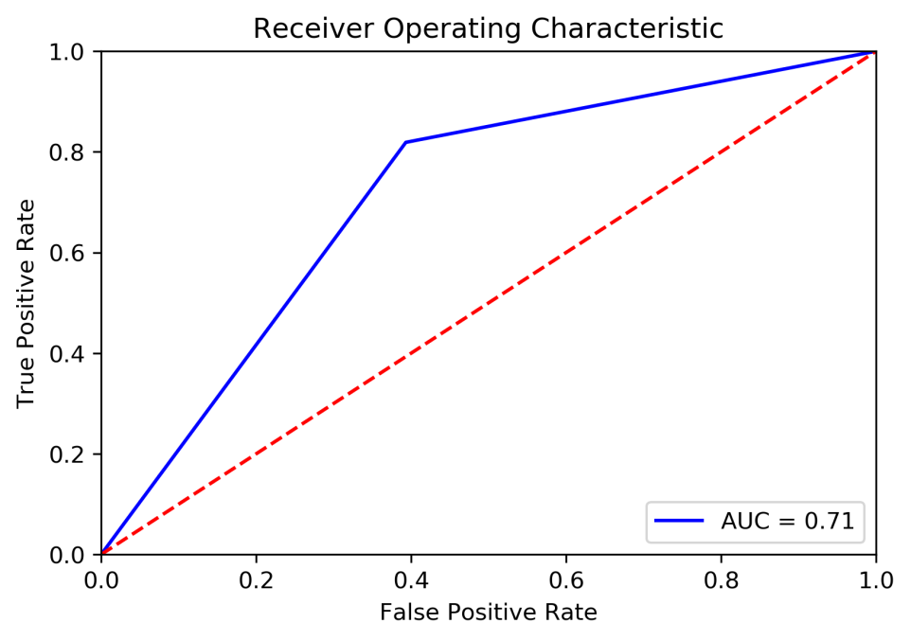
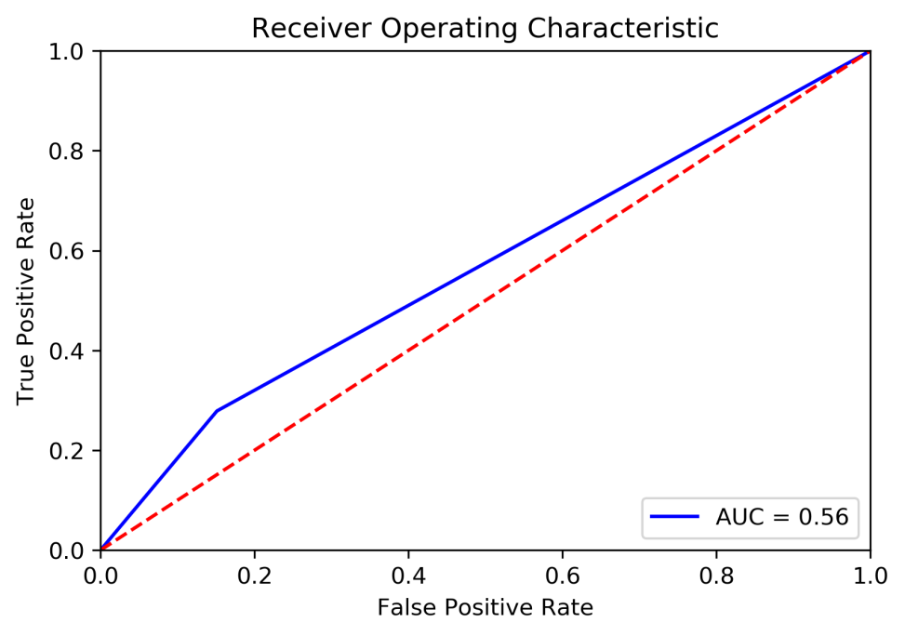
Prediction
Among these models, XGBoost performs the best, so I choose XGBoost to be my model.
Model selection – All classification models
Decision Tree
Logistic regression
KNN – binary
Auc = 0.8
F1 score = 0.59
Auc = 0.71
F1 score = 0.53
Auc = 0.56
F1 score = 0.57

Slide 31
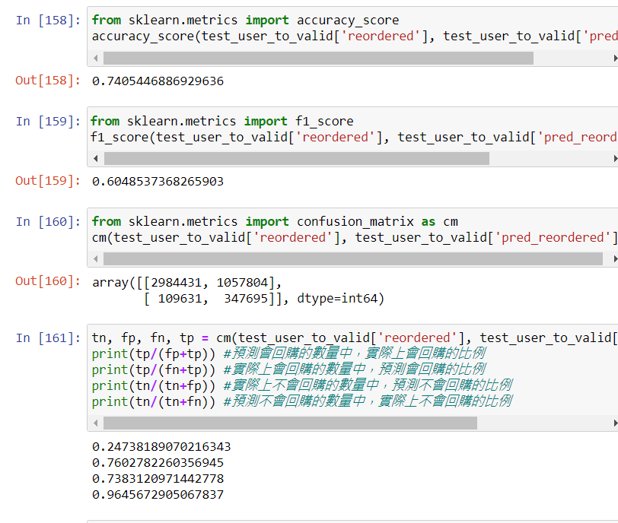
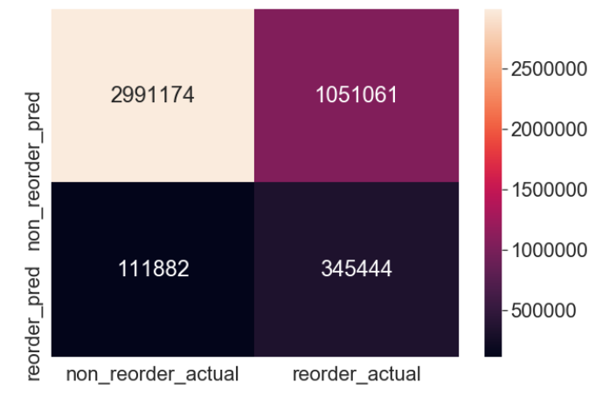
Prediction
With the binary algorithm, the target value doesn’t reach my expectation
Model optimization – XGBoost(Binary VS Reg:logistic)
XGBoost - binary
TP rate is low
Notes:
With the binary algorithm, the target value doesn’t reach my expectation
My target is that the TP rate can be higher, so that the model can help precise marketing.
I change the algorithm to regressor, in order to set the threshold for reordered or non-reordered by myself

Slide 32
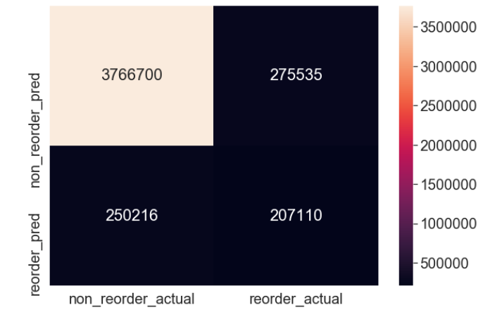
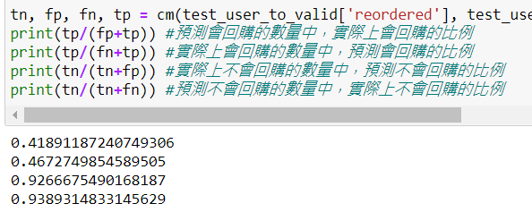
Prediction
Model optimization – XGBoost(Binary VS Reg:logistic)
XGBoost - regressor
The TP rate is obviously higher, so I choose to use regressor in XGBoost model

Slide 33
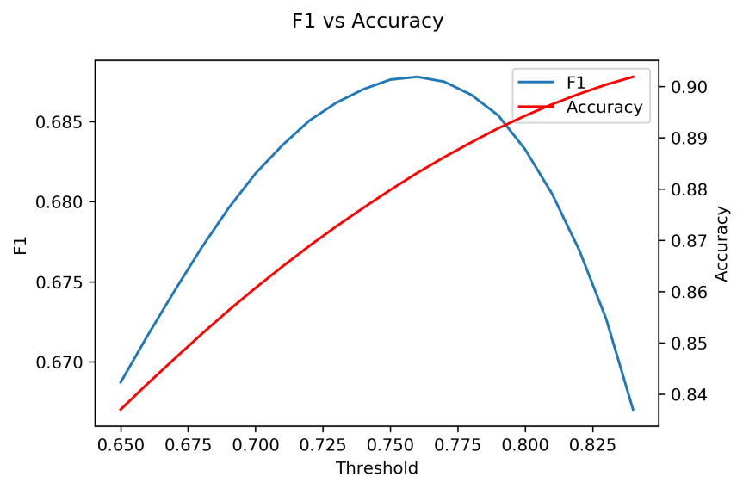
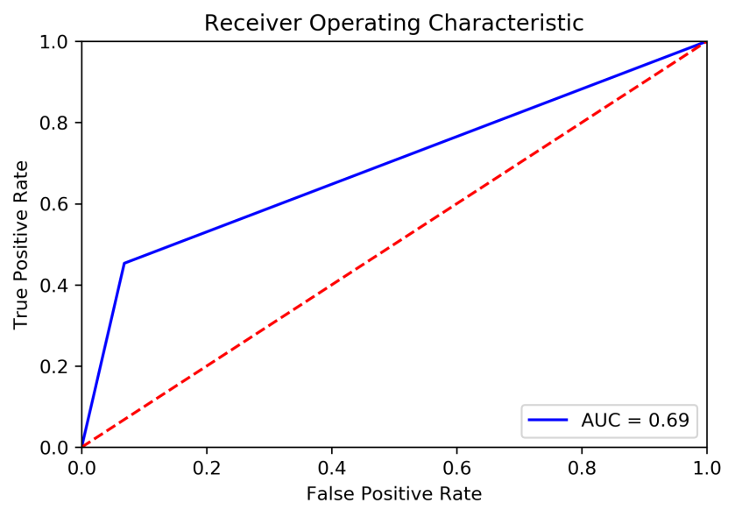
Prediction
Model optimization – XGBoost
(before choosing variables)
XGBoost – regressor
Threshold = 0.76
Accuracy = 0.88
F1 score= 0.69
XGBoost – regressor
Auc = 0.69

Slide 34
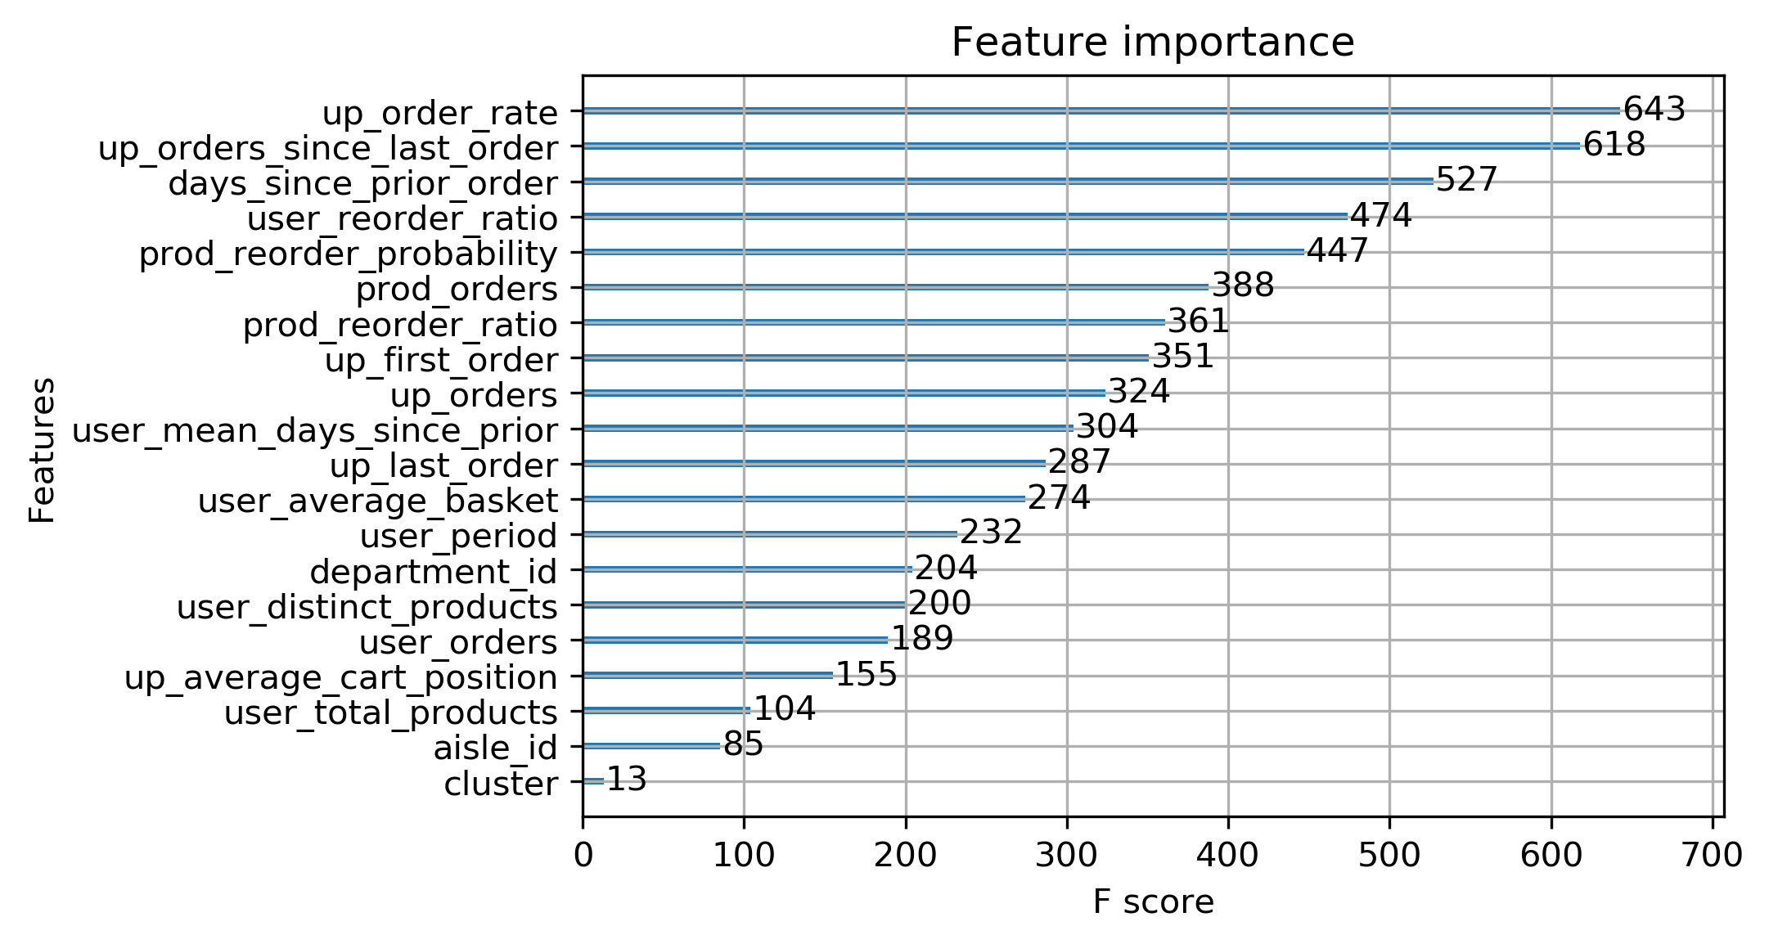
Prediction
Model optimization – XGBoost (choosing variables)
Check the importance of all the variables that are used in the model, remove the variables that is not important.

Slide 35
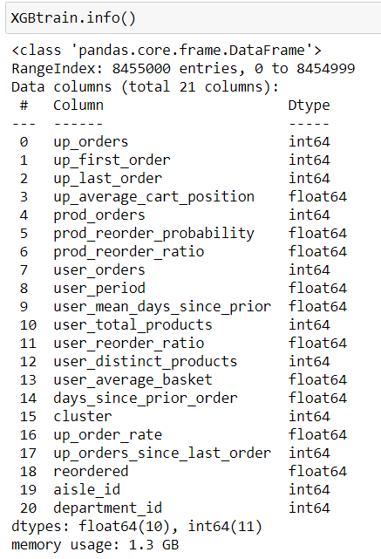
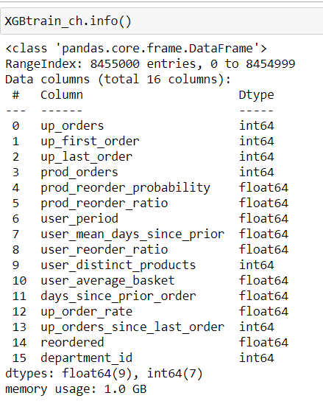
Prediction
Model optimization – XGBoost (choosing variables)
Choosing variables
Columns remove-> memory usage decreased
Model fit stay the same
Notes:
After filtering the variables, the memory usage is cut down to 1/4 less than the original.

Slide 36

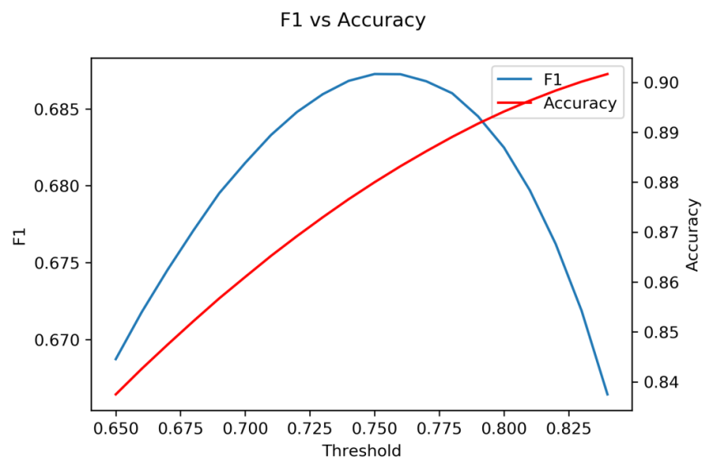
Prediction
Model optimization – XGBoost
(after choosing variables)
XGBoost – regressor
XGBoost – regressor
Threshold = 0.75
Accuracy = 0.88
F1 score= 0.69
Remain the same
Auc = 0.7
Increase 0.1 than original
Notes:
the accuracy and f-score of the model remain the same(0.88, 0.69), and the auc is 0.7, increased 0.1 more than the model without choosing variables

Slide 37
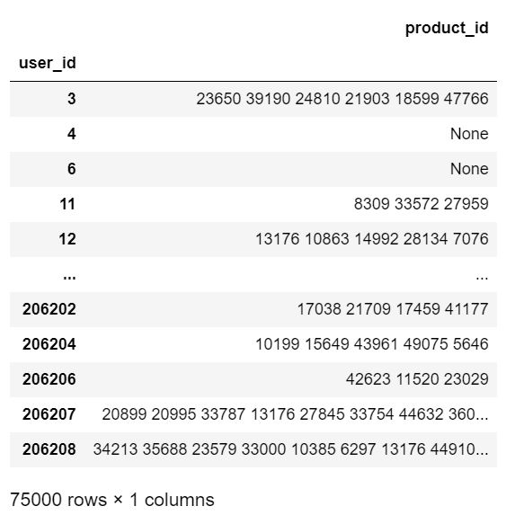
Prediction
Model result– XGBoost
Product_id
The product_id showing up on the table means that the user will reorder these products.
None
It means that the user won’t reorder in the next time.
Notes:
Here is the prediciton result.
Through the prediction result, we can know that which user will reorder and which products will be reordered.

Slide 38
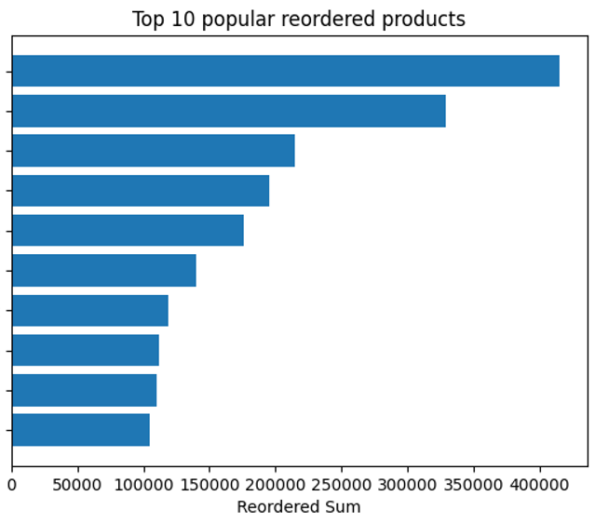
Association
Top 10 popular reordered products
produce is reordered by customers far more than other products
Department name | Aisle name | Product name
Produce | Fresh fruits | Banana
Produce | Fresh fruits | Bag of Organic Bananas
Produce | Fresh fruits | Organic Strawberries
Produce | Packaged vegetables fruits | Organic Baby Spinach
Produce | Fresh fruits | Organic Hass Avocado
Produce | Fresh fruits | Organic Avocado
Dairy eggs | Milk | Organic Whole Milk
Produce | Fresh fruits | Large Lemon
Produce | Packaged vegetables fruits | Organic Raspberries
Produce | Fresh fruits | Strawberries
Notes:
We found that produce is reordered by customers far more than other products.
In order to find association between other goods, in the following slides we will separately find the association in products with produce and the association in products without produce.

Slide 39
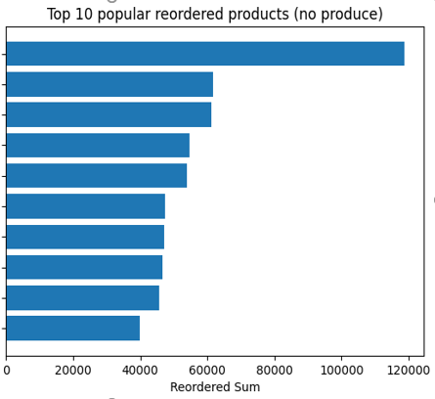
Association
Top 10 popular reordered products (no produce)
Department name | Aisle name | Product name
dairy eggs | milk | Organic Whole Milk
dairy eggs | cream | Organic Half & Half
beverage | water seltzer sparkling water | Sparkling Water Grapefruit
dairy eggs | cream | Half & Half
deli | fresh dips tapenades | Original Hummus
beverage | water seltzer sparkling water | Spring Water
dairy eggs | packaged cheese | Organic Whole String Cheese
bakery | bread | 100% Whole Wheat Bread
dairy eggs | soy lactosefree | Organic Unsweetened Almond Milk
dairy eggs | milk | Organic Reduced Fat 2% Milk

Slide 40
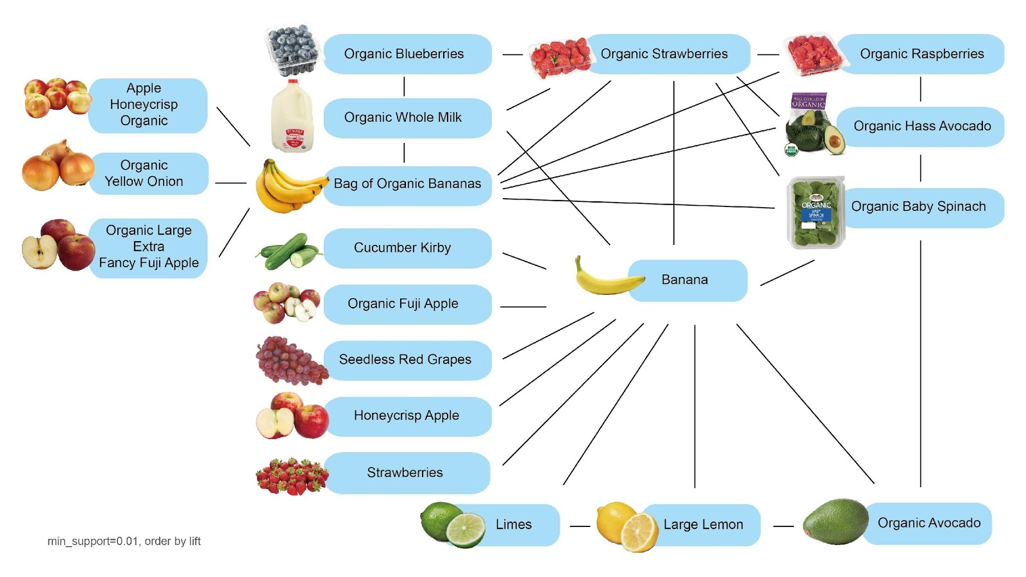
Association
Find Association of top 100 popular products
(in Apriori Algorithm)
Threshold:
Min_support=0.01
Order_by lift
The association connection exists between:
fruits and vagetables
fruits and milk
Credit by Iv chen
Notes:
Customers liked to buy fruits and vegetables together.
Customers may buy fruits and milk together.

Slide 41
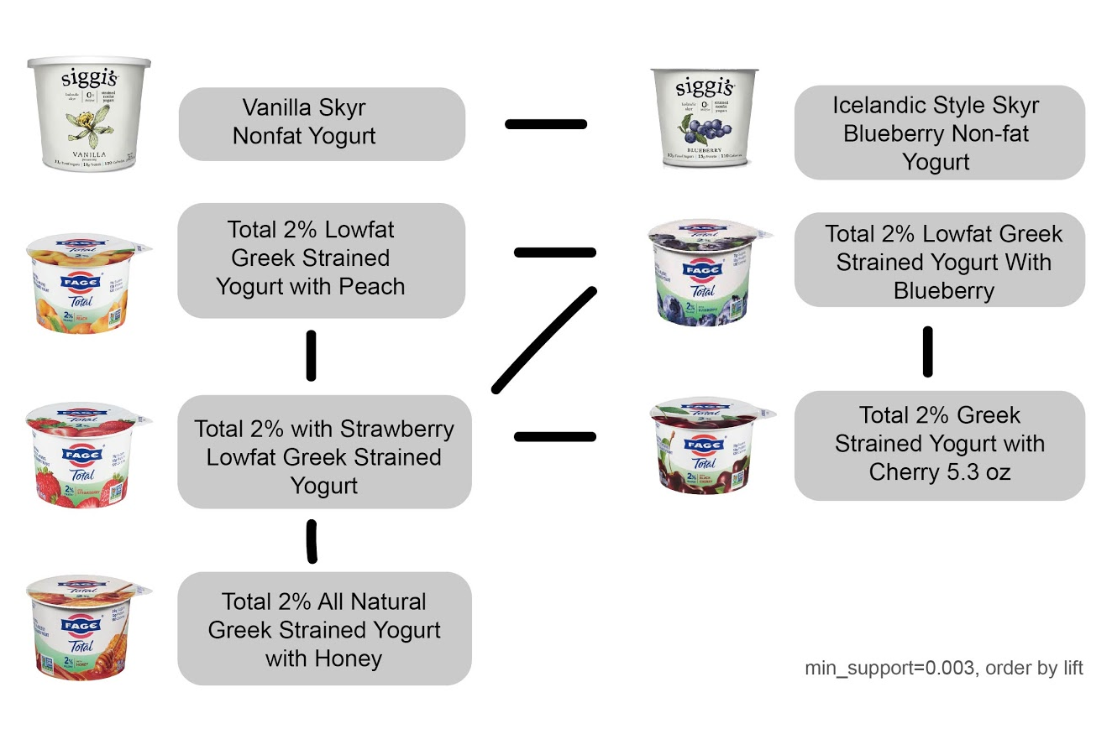
Association
Association of top 100 popular products(no produce)
(in Apriori Algorithm)
Threshold:
Min_support=0.003
Order_by lift
The association connection exists between:
Yogurts in different flavors
Credit by Iv chen
Notes:
Customers liked to buy different flavors of yogurt.

Slide 42
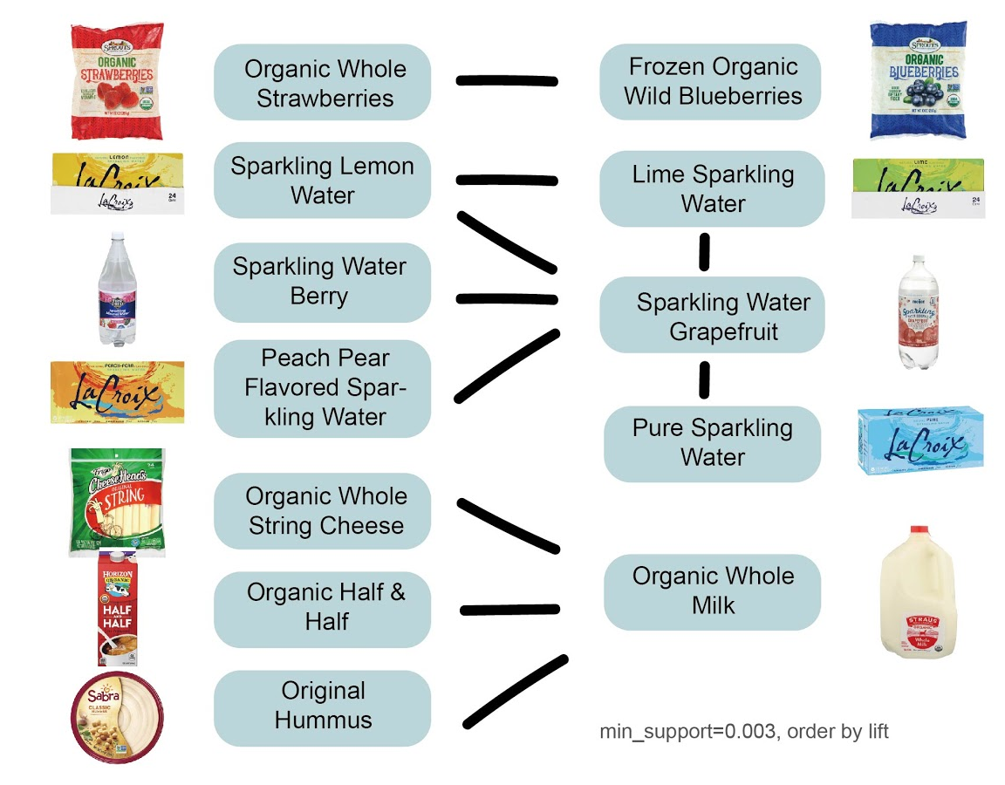
Association
Association of top 100 popular products(no produce)
(in Apriori Algorithm)
Threshold:
Min_support=0.003
Order_by lift
The association connection exists between:
Water in different flavors
Milk and cheese
Credit by Iv chen
Notes:
Customers liked to buy different flavors of water.
Customers who bought milk may buy cheese.

Slide 43
Conclusion
What can company do with these model and prediction result?

Slide 44
Conclusion
E-COMMERCE
INTERNET SHOPPING
01
Optimize the recommendation system
As we know the association between products, we can design a recommendation system based on the association rules.
02
Fulfill the precise marketing
By analyzing data, we can know who will reorder and which products will be reordered, so that we can release coupon and advertisement only to customers that is predicted by our model, so that we can cost down.
03
Decide the position of products in the store
Stores can place their products based on the association result, so that customers can buy products more conveniently.
04
Customize personal order interface
Now with the clustering result, we know that customers can be clustered into 3 groups. Website can be customizedly designed based on feaures in the group, which customer belongs to.

Slide 45
THANK YOU
Insert the Subtitle of Your Presentation

